Slide 1

Unicycle project

Slide 2
Outline
Introduction
Framework
Diff. Flatn L & NL
Outpput state
parking

Slide 3
Intro

Slide 4
Framework

Slide 5
TRAJECTORY TRACKING - STATE ERROR FEEDBACK

Slide 6
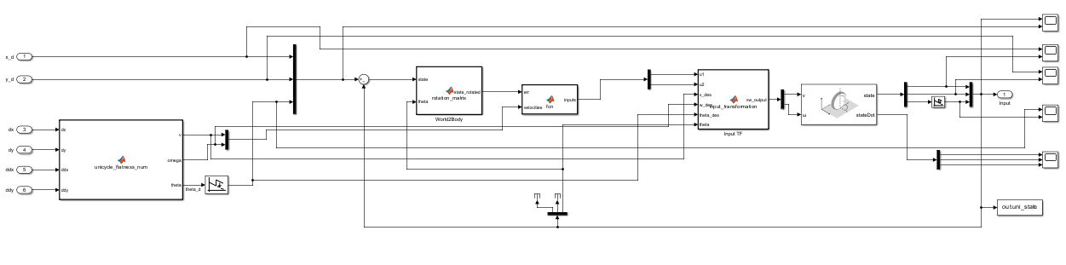
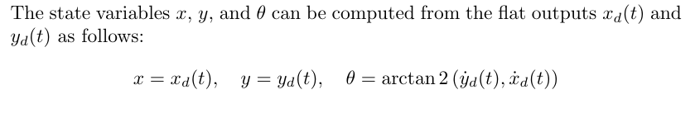
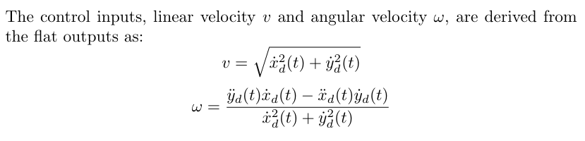
Linear case
explain also the wrap / unwrap thing ?
General overview --> explain the general strcuture, all the blocks and why

Slide 7
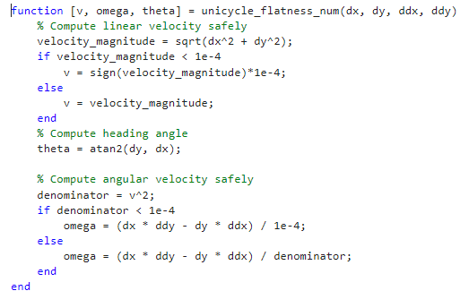
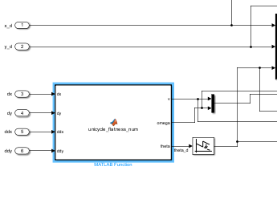
Avoiding division by zero

Slide 8
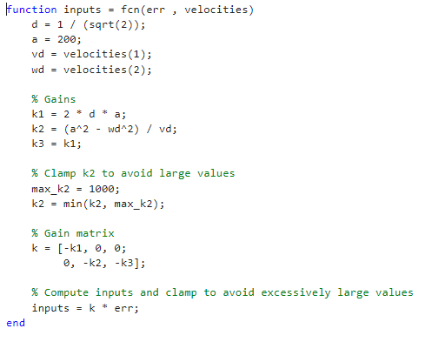
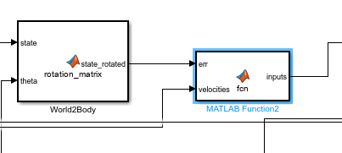
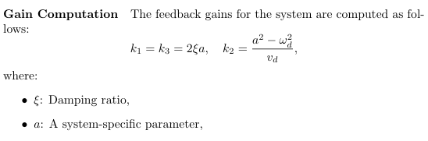
Gains and parameters --> gains: also plot where they lives ?

Slide 9
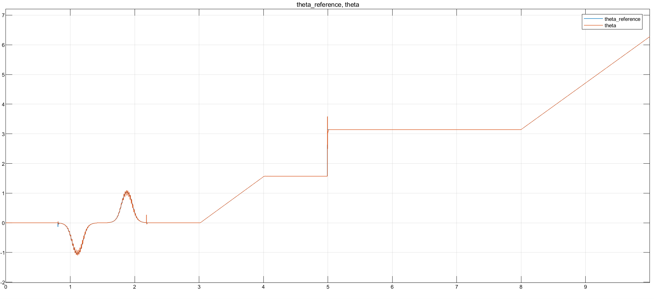

Slide 10
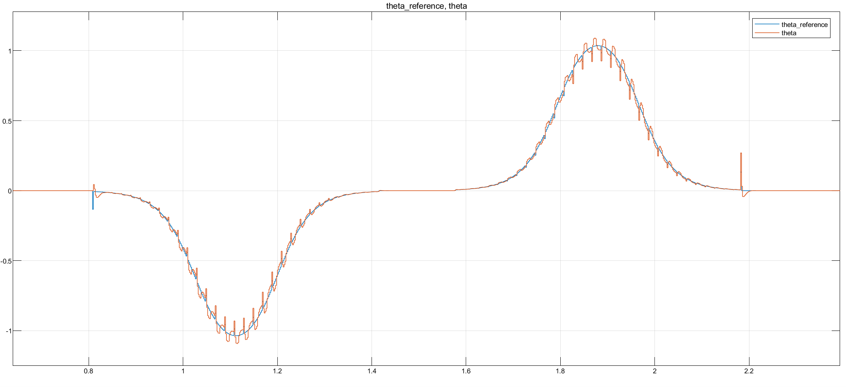

Slide 11
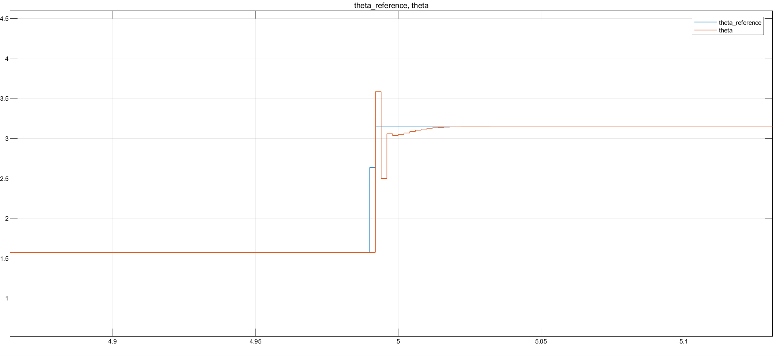
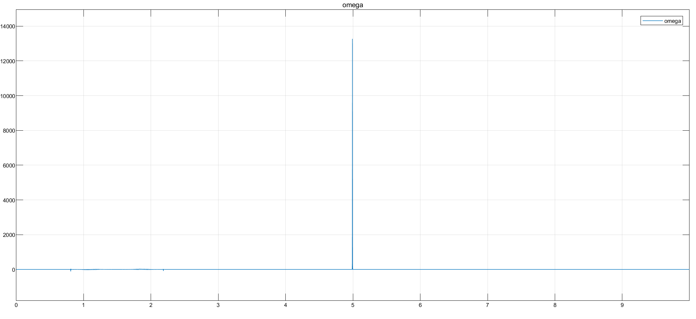
Focus on sharp curve
As expected from theory, differential flatness block should not be able to compute the input velocities when reaching a non differentiable part of the trajectory. Indeed, impulses in both velocities arises, with stronger effect in omega, (its computation is based on the second order derivative).
Nonetheless, thanks to Simulink implementation of the derivative we have been able to overcome the problme and to finish the simulation anyway.

Slide 12
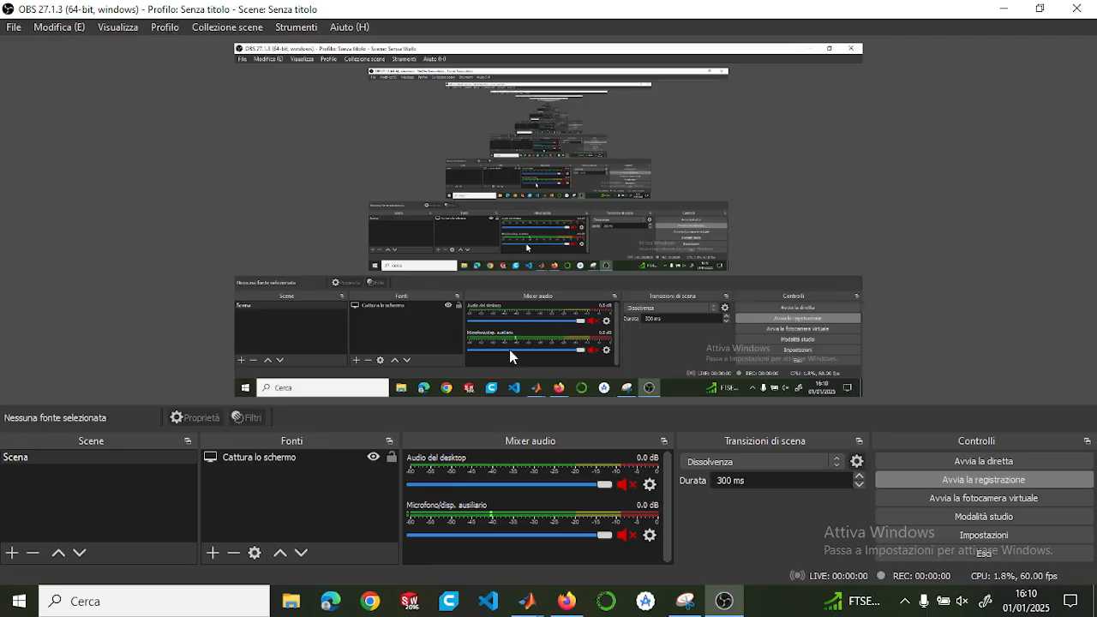
Video
Sistemare e tagliare video

Slide 13
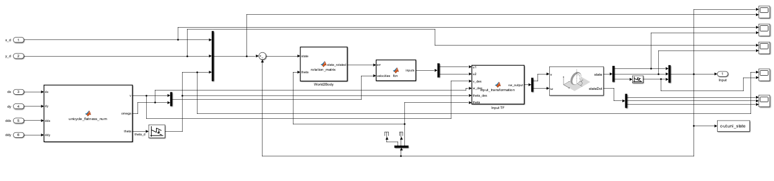
Non Linear case
NON LINEAR controller --> same structure , security checks … but different gain computations
explain also the wrap / unwrap thing ?
General overview --> explain the general strcuture, all the blocks and why

Slide 14
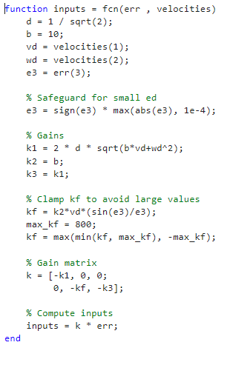
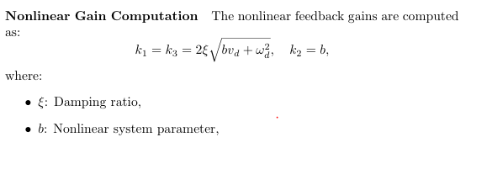
Gains and parameters

Slide 15
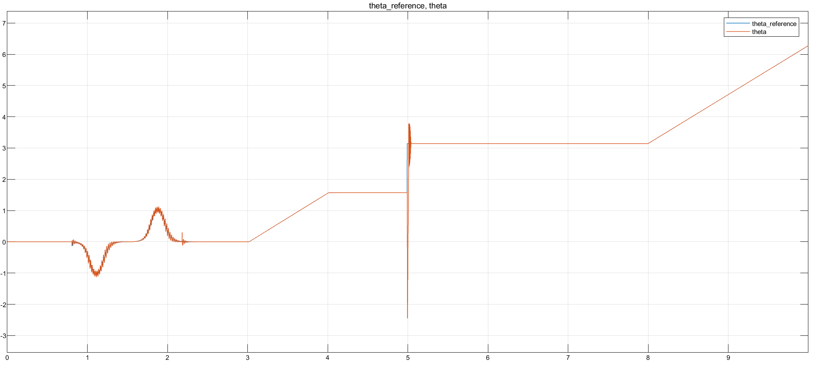
Plots --> see if impulse bigger than linear case follows some theoretical thing or just related to gains tuning

Slide 16
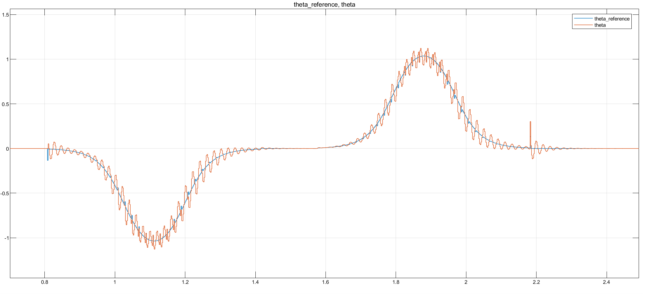

Slide 17
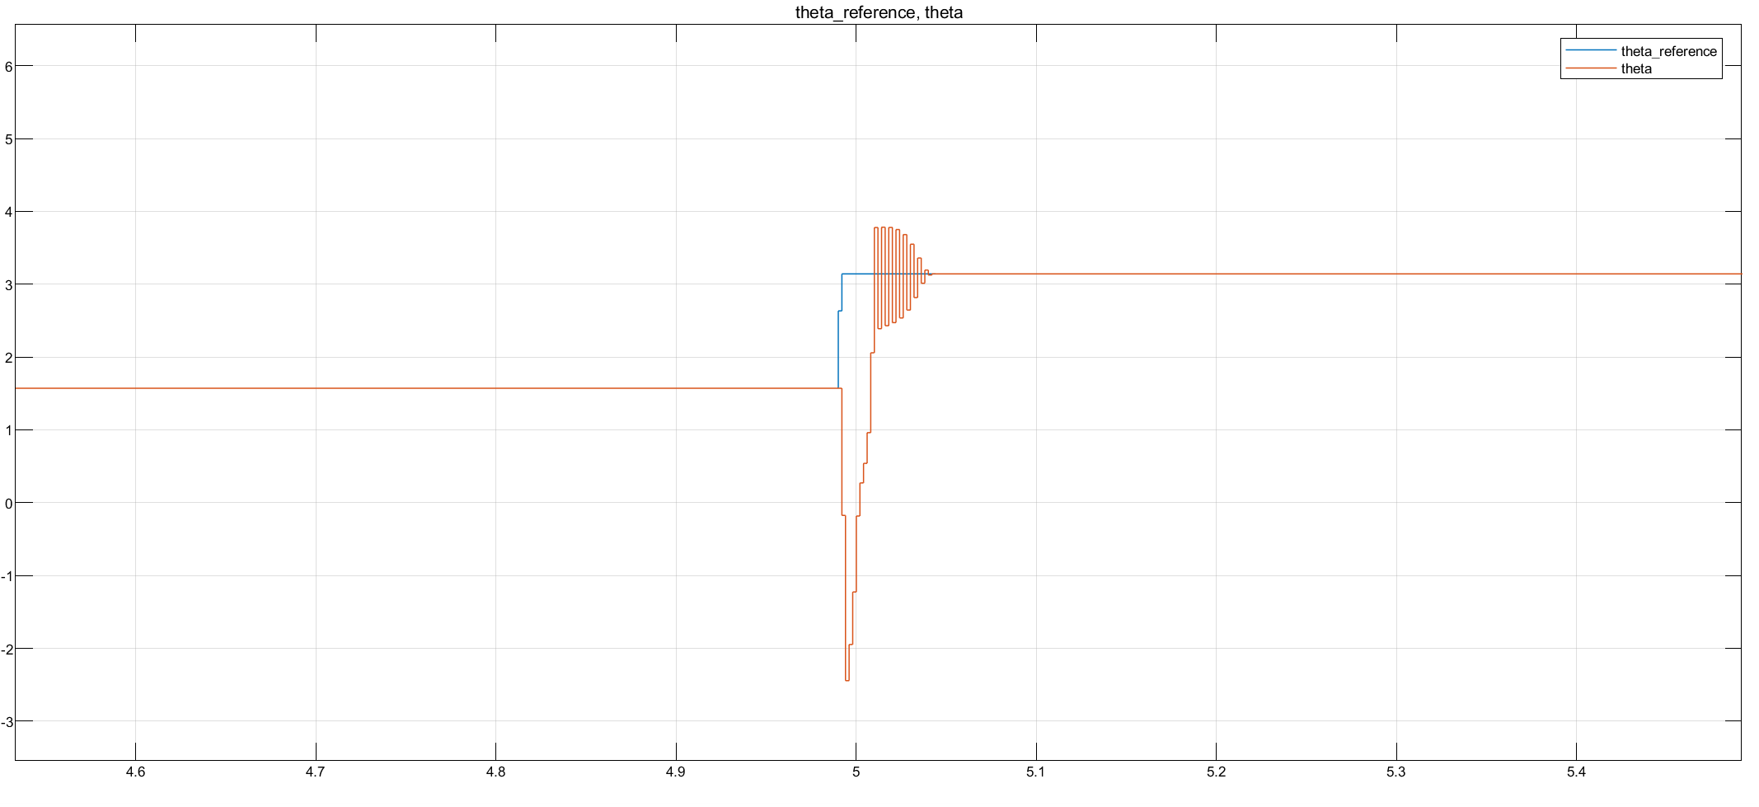
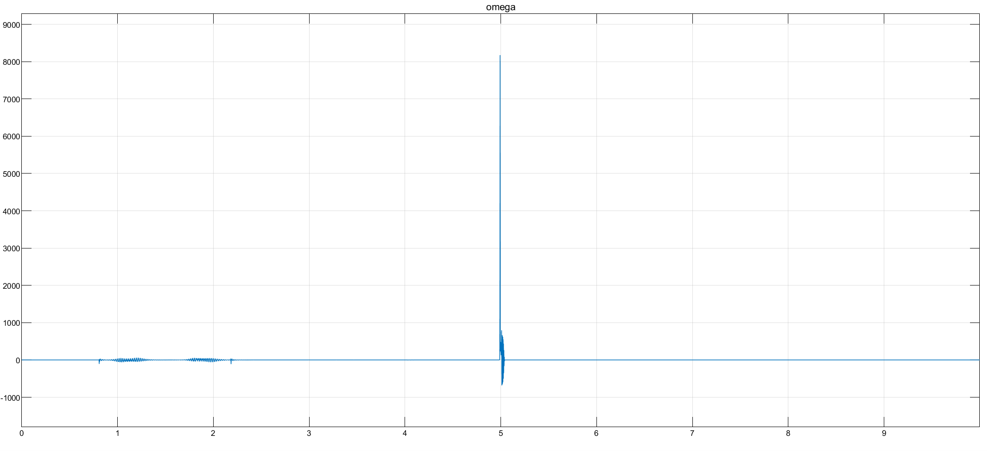
Focus on sharp curve
Make a consideration regarding NL more enhanced wrt lineare case, maybe theres a reason

Slide 18
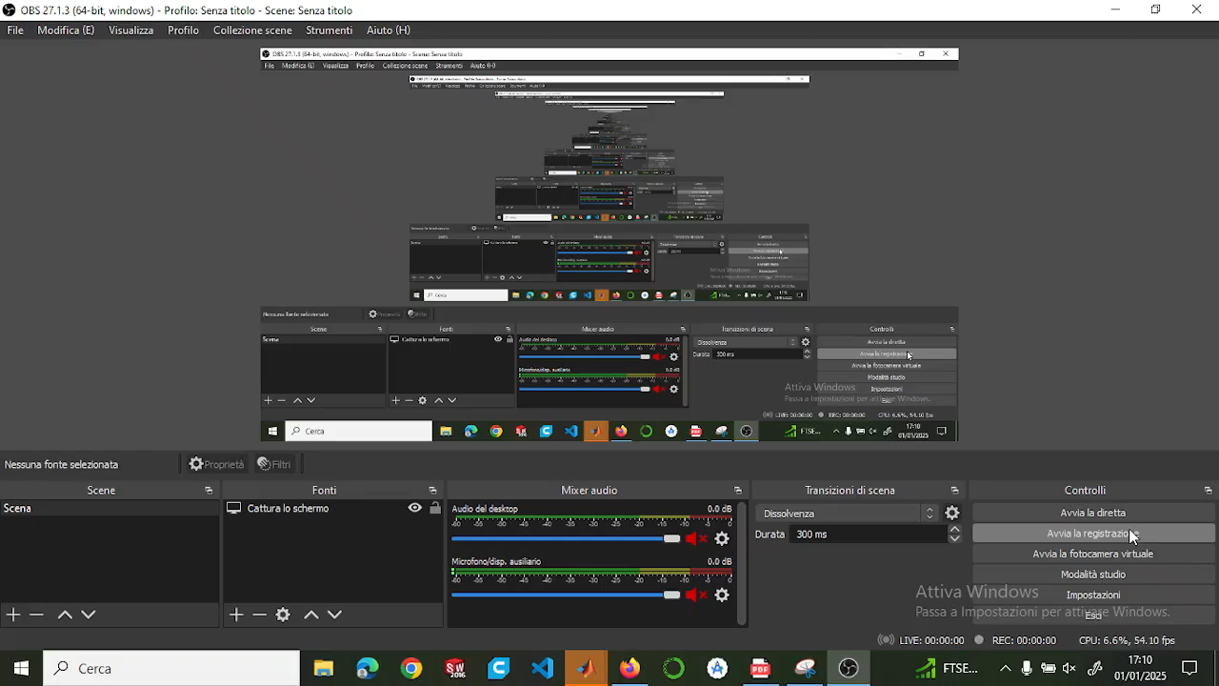
Video
Sistemare e tagliare video

Slide 19
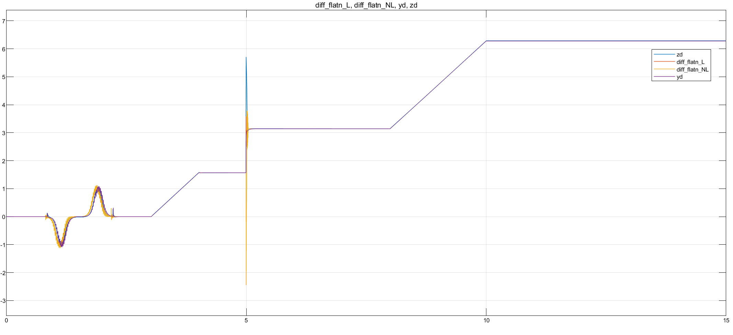
Plots of all controllers together

Slide 20
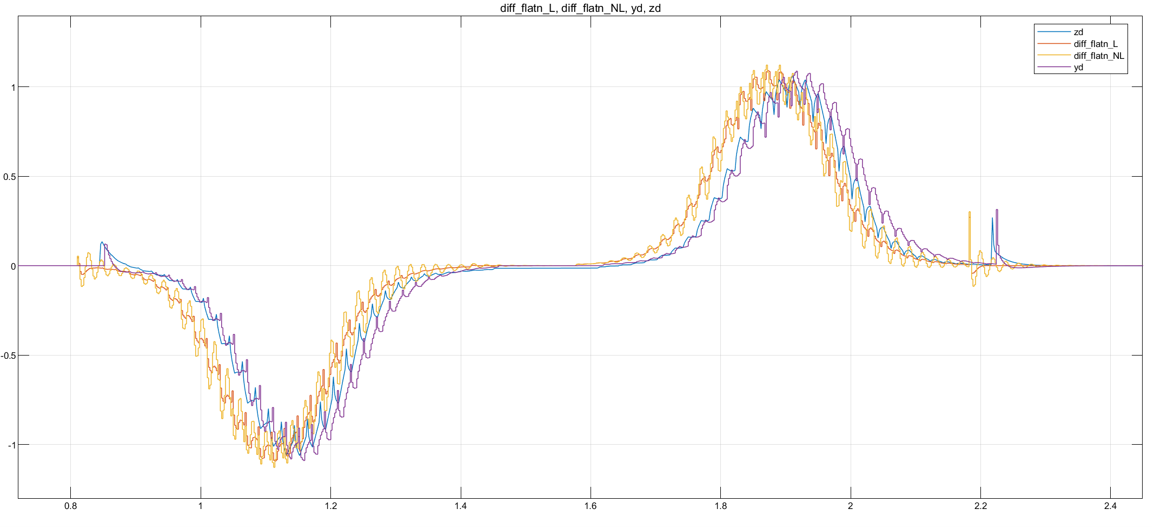

Slide 21
